Slide 1
Collecting State Trial Court Files: How Law Schools and Libraries Can Teach & Preserve History (and Use Technology to Do It)
Rachael G. Samberg
Reference Librarian
CALI Conference
June 21, 2012
Notes:
Why we’re here
State of state court files
Legal landscape for preservation (esp. in CA)
Stanford Collection
How we can work together

Slide 2
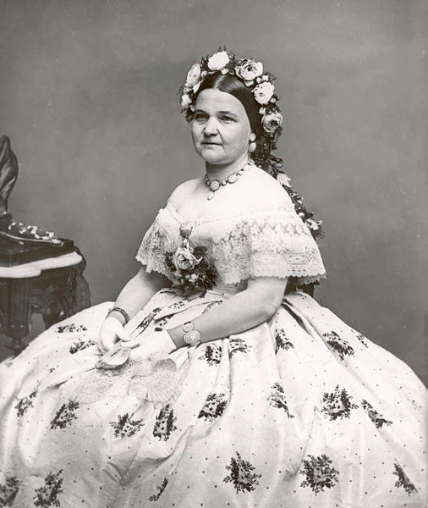
Mary Todd Lincoln’s Insanity Trial Papers Located in Court House
Court held 1875/1876 trial docs, including son’s petition for insanity declaration. Mary had been wandering Washington with government bonds sewn in her clothes. (“Mary Todd Lincoln Documents Sent to Lincoln Library,” Oct. 31, 2011)
Discovered by two Illinois Supreme Court Justices researching the trial for a reenactment. (“Mary Todd Lincoln’s Commitment Papers Held by the Clerk of the Circuit Court of Cook County for almost 140 years,” Dec. 19, 2011)
Image courtesy Wikimedia Commons
CALI Conference
June 21, 2012

Slide 3
Texas Task Force
Research by Kroger and Tx. Sup. Ct. Chief Justice Jefferson for 19th-century case file. Records in poor condition, overflowing.
Tx. Supreme Court appointed task force to assess status and develop protection plan
Judges, lawyers, professors, clerks; archivists from State Library and Archives Comm., Historical Comm., Tx. Sup. Ct., and State Bar
Survey distributed to clerks in 254 counties. 17% had records dating to Republic (1836-1845), 23% had early statehood (1846-1845), and 36% had records beginning 1877-1920
Still on file: Sam Houston v. Mirabeau Lamar, early statehood and Mexican land grant disputes, Pre-Civil War slavery records, trials for John Wesley Hardin, Bonnie & Clyde, etc.
CALI Conference
June 21, 2012

Slide 4
Not Every File Contains a Famous Trial, But They’re All Valuable
Vermont State Archives and Records Admin.’s grant:
“[T]he records chronicle not only the Vermont judicial system but also the larger American experience, and will expand perspectives on numerous issues, including crime and punishment, economics, and all facets of social history.” (VSARA In the News, Autumn 2011)
Cal. Rule of Court 10.855 expressly recognizes:
“establishes a program to preserve in perpetuity for study by historians and other researchers…to document the progress and development of the judicial system, and to preserve evidence of significant events and social trends.”
CALI Conference
June 21, 2012

Slide 5
Legal Lessons…Too Many to List!
Substantive Law
Lawyering
Contract terms, interpretation, enforcement
Property rights (e.g. easements, licenses)
Claims/crimes (e.g. assumpsit, trover, “Marking Unmarked Hog Without Consent of Owner”)
Statutory construction
Evidence (e.g. what can be used as proof of contract)
Remedies & sentencing
Trial & discovery tactics (e.g. deposition questions, structure/arguments of briefs and pleadings)
Views on advocacy and professional responsibility
Jury instructions & judge styles
Litigation costs
CALI Conference
June 21, 2012

Slide 6
Social History in Trial Court Records
Lives of former slaves
Due process or lack thereof (e.g. sentenced to be hanged, whipped, branded; yet counsel were sometimes appointed, and appeals were available)
Court files often only extant written records
Lives of women
Property ownership rights
Trends in domestic violence
Divorce patterns/statistics
For more, see Mar. 2012 Texas Bar Journal,
“A History of Texas in 21 State Court Records”

Slide 7
Files are in Jeopardy Nationwide: Disarray, Decay, and Destruction
Clerks running out of space
Lack of funds to digitize or care for aging records
Retention schedules may require destruction, esp. of originals after microfilming/digitization.
Results in loss of history. States taking notice!
In April 2012, a historian’s dissatisfaction over being unable to find 19th century murder case file led to Missouri Sec. of State creating “Local Records Preservation Project” to organize and preserve trial court records. (See “Truman Students Help Preserve County Court Records,” Apr. 18, 2012)
CALI Conference
June 21, 2012

Slide 8
Who’s Involved in State Trial Court Record Preservation
Court Clerks
State Archives & Archivists
Secretary of State
State Historical Societies & Universities
State Supreme Court Judges
State Bar Associations
Who to ask, and what rules to follow?
CALI Conference
June 21, 2012

Slide 9
Why So Many People are Involved: Numerous Applicable Laws & Policies
State statutes
Rules of Court
Records Retention Schedules
Often issued by State Archives or Historical Societies, authorized by the courts to advise
Internal Policies at State Archives, etc.
Need to look beyond the letter of the law…
CALI Conference
June 21, 2012

Slide 10
Correspondence with Vermont Archivist
“The management of archival court records in Vermont has not been as uniform a process as the statutes or regulations might lead you to believe. For decades prior to the creation of VSARA…the courts were free to give away the paper records to historical societies, the University of Vermont, or other entities...
With the creation of VSARA (which consolidated the state’s records management program with the state’s archival program)…[c]ourts no longer transfer their records to whomever they like …and the State Archives is now the sole repository for the state’s archival records.”
Personal communication from S. Reilly, June 13, 2012

Slide 11
Making Sense of Preservation Paradigms: Two Foci for Interested Institutions
Mandatory or permissive destruction
Question of who can request/take the files. Two main scenarios:
Lets state archives, historical association and/or state university accept them
Lets unaffiliated institutions accept them
CALI Conference
June 21, 2012

Slide 12
Results of My 10-State Survey
State | Destruction Paradigm | Availability for Unaffiliated Cultural Institutions
California | Permissive | Yes
Georgia | Permissive | No
Idaho | Permissive | No
Illinois | Permissive | Yes
Oklahoma | Permissive | Yes
Pennsylvania | Permissive | No
South Carolina | Permissive | Yes (if approval is given by Dept. of Archives & History and court administration)
Utah | Mandatory | No
Vermont | Permissive | No
Wisconsin | Permissive | No (except U. Wisc. and Superior Public Library)
CALI Conference
June 21, 2012

Slide 13
California’s Paradigm
Permissive destruction
E.g. gen’l civil records retained at least 10 yrs after disposition
Sampling program
Keep everything before 1910. For 1910-1950, keep 10% plus 2% of a subjective sampling of records slated for destruction.
Two counties required to retain all paper records from that year.
Records are available for transfer to unaffiliated institutions
Upon request to and approval by the superior court.
Notice of any intended trial court record destruction
Must be given to organizations maintained on master list held by Judicial Council, and entities that have requested to be informed.
Records Management Clearinghouse
“Referral center for historians and researchers”
CALI Conference
June 21, 2012

Slide 14
How California Trial Courts Provide Notice of Intended Destruction
CALI Conference
June 21, 2012

Slide 15
How Institutions Request Transfer of “To Be Discarded” California Court Files
CALI Conference
June 21, 2012

Slide 16
Other California Trial Court Records Collections
Huntington Library: Several collections, but most notably Los Angeles Area Court Records, 1850-1899
See finding aid and description at: http://hdl.huntington.org/cdm/compoundobject/collection/p15150coll1/id/1920/rec/6
Berkeley’s Bancroft Library: Clusters of ranges from particular superior courts, private contributions, specific cases, etc.
See, e.g., http://www.oac.cdlib.org/institutions/UC+Berkeley::

Slide 17
The Stanford Law School Collection
Not a lot of processing yet! Stay tuned.
Accumulated over time by professor
Approximately 100 boxes total
In sum, approx. 3500-4000 individual case files
Older files: Probate, guardianship, general civil (e.g. breach of contract)
Newer files: Domestic violence, some criminal
CALI Conference
June 21, 2012

Slide 18
The Storage Process
Student worker transferred case files from boxes into hanging folders, individually labeled with box number
Spreadsheet tracks box location in numbered cabinets
Costs: File folders and work-study student
Space Requirements: 209 ft³ (Each filing cabinet 19 cubic feet, and collection of 100 boxes fills 11 filing cabinets).
Tommy
CALI Conference
June 21, 2012

Slide 19
What can we learn and teach from these cases?
Four randomly-selected files reveal California legal history and substantive law
CALI Conference
June 21, 2012

Slide 20
1. Du Ray Smith v. Helena M. Tucker Court: Alameda County Superior Filed: 1906
Lessons in California Contract Law
Complaint alleges D agreed to sell P parcel of land for $1110, for which P put down $200 deposit. P ready and willing to pay remainder, but D wouldn’t tender the deed or accept remaining payment
CALI Conference
June 21, 2012

Slide 21
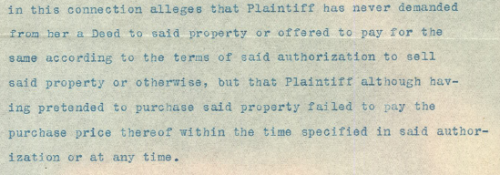
Tucker’s Answer: Denials
Contracts: Answer asserts that D authorized sale for full payment to be made within 30 days. P never paid anything
Evidence: Asserts “correct” copy of agreement is attached (but it’s D’s attestation of terms)
Remedies: Request for declaration that no sale is required (no specific performance)
Exhibit A: The Agreement
CALI Conference
June 21, 2012

Slide 22
Lessons in Civil Procedure: Complaint Dismissed for Failure to Prosecute
CALI Conference
June 21, 2012

Slide 23
Teaching Court Files With Secondary Sources: Hard Times for the Du Ray Smith Family
Born in 1856, Du Ray Smith arrived in Oakland at 18 and opened a record-searching office. (S.F. Chronicle, Apr. 20, 1913, p. 41)
In 1893, he and ex-wife joined forces in a land dispute to recover $10,000 ranch investment. (S.F. Chronicle, Jan. 15, 1893, p. 15).
Fell on hard times. His accounts and investments were in dispute when, in wake of Tucker lawsuit, he shot himself in the lavatory of his office at 1037 Broadway in Oakland. (S.F. Chronicle, Apr. 20, 1913, p. 41).
Survived by his second wife, a 7-year-old son, and two sons from his first wife, Emily Scott. Emily was daughter of So. Cal.’s largest land-owning forty-niner, and died from successive “nervous breakdowns” after Du Ray’s suicide. (L.A. Times, Oct. 13, 1919, p. II 10)
CALI Conference
June 21, 2012

Slide 24
2. Reinhold Glinka v. Joseph Wundsch Court: Alameda County Superior File Date: 1894
Complaint : Sept. 1, 1894, P & D enter into partnership to sell tin wares. “The Oakland Tinware Factory.”
Oct. 13, 1894, D took “exclusive possession” of Factory, locking doors. D later re-opened, but would not permit P to participate in profits from sale of goods in which P & D equally invested.
P requests appointment of receiver to dissolve business, valued at over $625.
CALI Conference
June 21, 2012

Slide 25
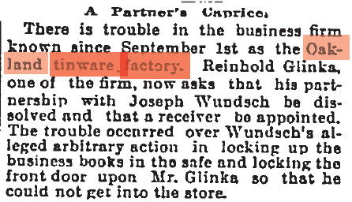
The case makes the news…
S.F. Chronicle, Oct 19, 1894, p. 10
CALI Conference
June 21, 2012

Slide 26
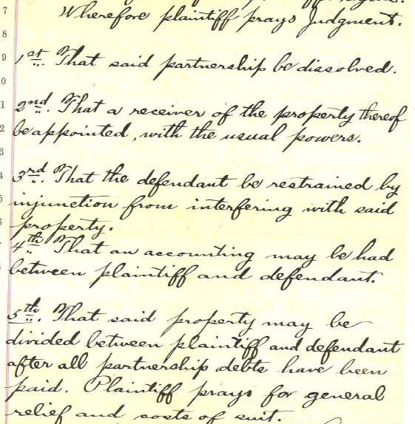
Glinka’s Prayer for Relief
Law of Remedies: What is a party entitled to when agreement is “violated”?
Injunctive relief, costs of suit, accounting, etc.
CALI Conference
June 21, 2012

Slide 27
Wundsch Files Answer & Cross-Complaint…
Asserts P’s only contributions were: circle & table shears, double seamer. No other capital investment.
D performed all covenants, P did not – resulting in Cross-Complaint because:
It was P who locked D out of store.
P defrauded D by selling off goods and pocketing cash.
P & D had “agreed” that if a party defrauded the other, the other party could take sole possession & ownership.
CALI Conference
June 21, 2012

Slide 28
Wundsch Attaches Agreement
Contract Law: Excellent examples of language, terms & conditions
Evidence Law: “Copies” of agreements are often attestations of terms rather than counter-signed copy.
CALI Conference
June 21, 2012

Slide 29
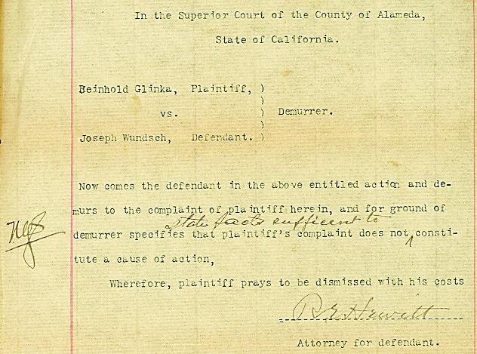
Wundsch Files Demurrer
Civil Procedure: Failure to state cause of action; also, both demurrer & answer?
Civil Procedure: Grounds set forth in “Affidavit,” apparently functioning as a Memo of Points & Authorities
CALI Conference
June 21, 2012

Slide 30
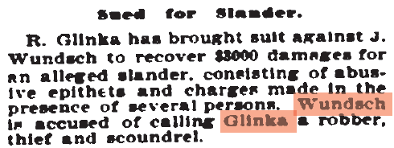
How was the case resolved?
No judgment in file, but the demurrer Affidavit reveals the Court appointed a receiver to dissolve partnership. Parties return one year later: Defamation!
San Francisco Chronicle, Oct. 13, 1895
San Francisco Chronicle, Jan. 16, 1896, p. 11
CALI Conference
June 21, 2012

Slide 31
3. Continental Bldg & Loan Assoc. v. R.L. Aitchison Court: Alameda County Superior File Date: 1894
Suit to resolve property rights, and for quiet title to land
P unable to serve summons because D couldn’t be found
Legal and cultural issues implicated by suit
CALI Conference
June 21, 2012

Slide 32
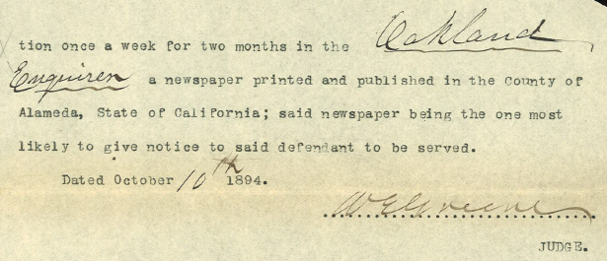
Civil Procedure: How to Serve Notice
CALI Conference
June 21, 2012

Slide 33
Intersection of Law & Race in 1890s Oakland
CALI Conference
June 21, 2012

Slide 34
Resolution of the Case
Property Law: Decree Quieting Title
CALI Conference
June 21, 2012

Slide 35
4. In the matter of Rudolf Bartsch, an Insolvent Debtor
Court: Alameda County Superior Filed: 1896
Request for declaration of insolvency, and permission for estate assignee to sell off property (12 tons clay, 409 vases, 2 turntables)
Reveals substance of Cal. debtor/creditor law, and useful for teaching legislative history
CALI Conference
June 21, 2012

Slide 36
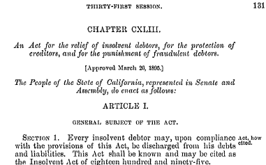
Petition Made Pursuant to Newly-Enacted Debtor Statute
Statutes 1895, p. 131, c. 143
CALI Conference
June 21, 2012

Slide 37
The Affidavit Bartsch filed tracks statutory language…
Bartsch’s Affidavit
Statutory Requirement
CALI Conference
June 21, 2012

Slide 38
The Insolvent Act of 1895 Replaced Equivalent Act of 1880
CALI Conference
June 21, 2012

Slide 39
But court forms took some time to catch up to the law…
Form still references the 1880 Act.
Blacksmithing work was expensive!
CALI Conference
June 21, 2012

Slide 40
Future Plans for the SLS Collection
Finding aids (internal & external research)
File entry into database using attributes like:
County
Court Name
Case Number
Party Names
Date Filed
Nature of Suit
Possible exportation of database files into S.U. catalog
Digitization?
Collaboration?
Which brings us to…
CALI Conference
June 21, 2012

Slide 41
Future Plans for Collaboration: Some Assembly Required!
Law schools and libraries can work together to rescue state trial court records in 3 main ways:
Participate in file acquisition & management in permissive states
Raise awareness in states with vague rules
Lobby to change restrictions in states where cultural institutions are overlooked/excluded
CALI Conference
June 21, 2012

Slide 42
Assembling the Pieces: Technology & Logistics
Working groups?
Web-based collection management?
Grants?
Texas Historical Comm.: Run by Texas Bar. Donations!
Vermont Grants: Vermont State Archives and Records Administration awarded $118,078 from the National Historical Publications and Records Commission to preserve and make more accessible archival court records, dating from 1794 to 1945.
CALI Conference
June 21, 2012

Slide 43
For now, each state’s historical files remain largely unassembled…
Open for your discussion, input, and interest.
Thank you for participating!
Rachael G. Samberg
Reference Librarian
rsamberg@law.stanford.edu
(650) 725-0806
CALI Conference
June 21, 2012
Notes:
Task Force’s Report can be found in full: http://www.supreme.courts.state.tx.us/crptf/docs/TaskForceReport.pdf
Check out Texas Bar Journal’s issue on work of the Task Force: http://www.texasbar.com/AM/Template.cfm?Section=Texas_Bar_Journal&Template=/CM/ContentDisplay.cfm&ContentID=17328

